Slide 1
Final Project: Men’s Basketball Database
analysis OF BASKETBALL DATABASE
for THE 2012 NBA draft

Slide 2

2012 NBA DRAFT: Sacramento Kings Edition
Last Season Record: 22-44 (.333 W%)*
Last Winning Season: 2005-06 (6 yrs ago)
Projected Overall Draft Pick in 2012: 5th (7.6% chance at #1)
Last 3 Drafts Picks:
2011: 1-10: G Jimmer Fredette
2010: 1-5: C DeMarcus Cousins (2010 All Rookie 1st Team)
2009: 1-4: G Tyreke Evans (2009 ROY)
*Only 66 Games Played in 2011-12 because of Lockout

Slide 3

Who do we draft?
What is one statistical area to Focus on when determining the type of player to draft?

Slide 4
Men’s Basketball Database
The Men’s Basketball Database contains individual and team statistics from professional basketball leagues including the National Basketball Association through the 2011-12 NBA season.
Took relevant Tables and converted into SQL local database.
Used 5 Tables: Draft, Allstar, Players, Master, Awards
Connecting column was the players’ unique ID.
Players: All Game Statistical Data Per Year
Draft: Lists every draft pick, player selected
Awards: List of Awards Players Received per year
Allstar: Lists all players selected/played in the NBA All Star Game, data up to 2009
Master: Master data info for every player ID (college, birthdate, birthcity, highschool)

Slide 5
Cleaning Methods Used
Removed columns with no data(firstseason, lastseason), incorrect data (Round 99, Pick 0), duplicate rows (draft data), replaced blanks
Took statistic raw data and converted into a per game stat: points per game, assists per game, rebounds, etc.
Created % data with Field Goal, Free Throw, and 3 Pointer
Replaced multiple position players with a single position, the one listed first: ‘C-F’ became ‘C’, ‘F-G’ became ‘F’, etc.
Took height data spilt into feet and inches
Brought together all relevant info into one table for Tableau

Slide 6
Parameters
Only Looked At Data from 1985 onward (1st year of Draft Lottery)
Total Draft Picks since 1985: 1882
Master Table Player IDs: 5061
Distinct Players who played in 1985 or greater: 2136
A Player must play 70% of his team's games (58 in 82-game season) to Qualify For NBA League Leaders
Players who played 70% or more games since 1985: 5825
Players who have played in All Star Game Since 1985: 588
Distinct Players who played in 1985 or greater: 2136
58 GP Minimum: No Data for 1998-99 Season & 2011-12 Data Limited (Lockout Seasons)

Slide 7
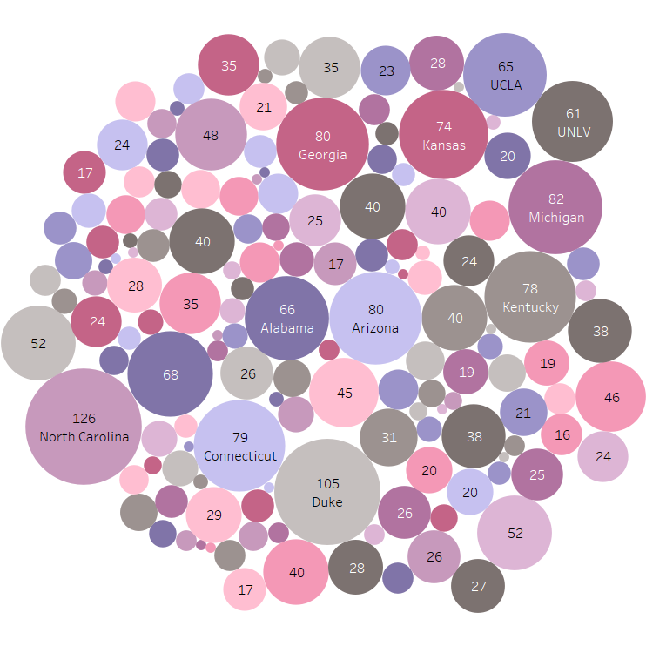
WHERE DO MOST TOP DRAFT PICKS COME FROM?
Which US Colleges HAVE BROUGHT in the most 1st Round Draft Picks since 1985?
Top 10 All Division I Schools

Slide 8
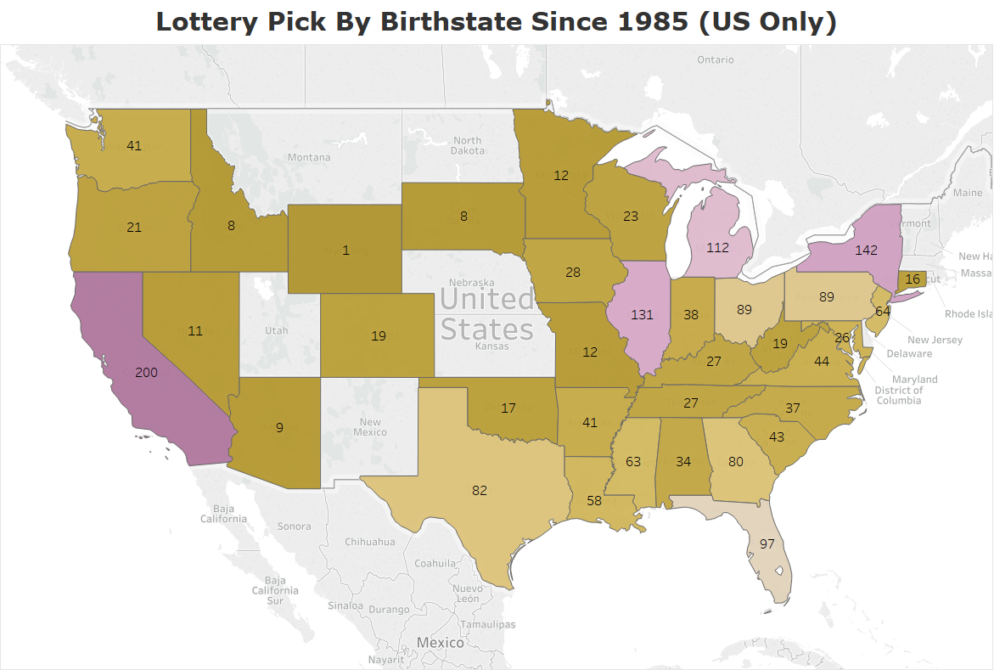
MOST US BORN LOTTERY PICKS (#1-14) FROM CA
Top 5 States:
CA 200
NY 142
IL 131
MI 112
FL 97

Slide 9
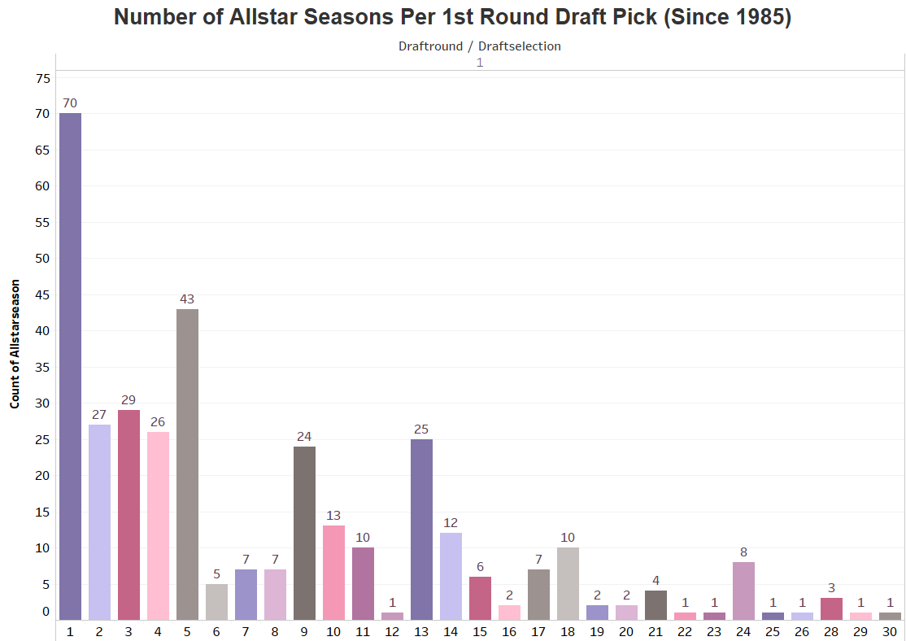
NBA ALL STAR Game Players are selected for annual exhibition match by fans media and current players. Usually the best players.

Slide 10
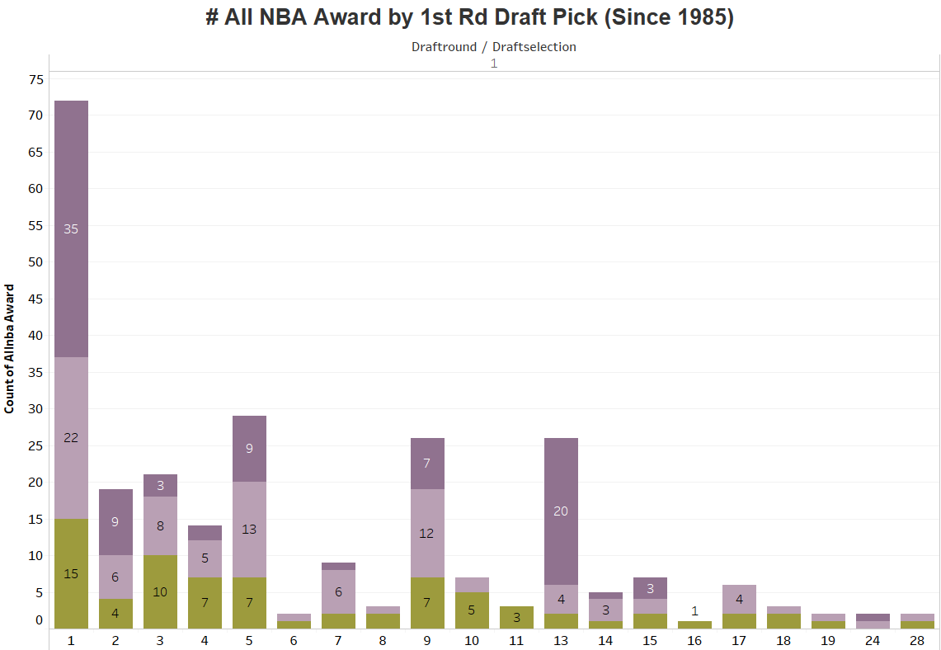

ALL NBA Annual honor bestowed on the best players in the league following every NBA season. The voting is conducted by a panel of sportswriters and broadcasters.

Slide 11
Importance of Drafting an All Star/All NBA Player Table Averages Based on Player Type (Since 1985)
 | Position | Minutes Per Game | Points Per Game | Rebounds Per Game | Assists Per Game | Steals Per Game | Blocks Per Game | Turnovers Per Game | Fouls Per Game | FG% | FT% | 3pt% | Draft Selection
All Players | C | 24.33 | 9.68 | 6.50 | 1.19 | 0.56 | 1.25 | 1.46 | 2.81 | 49.26 | 68.92 | 10.02 | 10.63
All Star | C | 35.28 | 20.03 | 10.23 | 2.31 | 0.93 | 2.18 | 2.64 | 3.09 | 51.17 | 74.79 | 14.76 | 3.73
All NBA | C | 36.31 | 22.63 | 10.86 | 2.56 | 0.99 | 2.41 | 2.69 | 3.07 | 52.45 | 71.86 | 14.54 | 2.41
All Players | F | 26.02 | 11.19 | 5.54 | 1.70 | 0.79 | 0.64 | 1.52 | 2.52 | 47.46 | 72.31 | 20.84 | 11.42
All Star | F | 37.03 | 21.58 | 8.47 | 3.51 | 1.27 | 1.02 | 2.61 | 2.77 | 49.71 | 77.09 | 26.50 | 7.17
All NBA | F | 37.79 | 22.86 | 9.37 | 3.82 | 1.37 | 1.09 | 2.80 | 2.74 | 50.37 | 75.56 | 26.31 | 5.90
All Players | G | 26.89 | 11.51 | 2.96 | 3.78 | 1.07 | 0.22 | 1.72 | 2.04 | 44.01 | 79.01 | 32.04 | 13.51
All Star | G | 37.34 | 21.33 | 4.42 | 6.39 | 1.69 | 0.37 | 2.80 | 2.32 | 46.25 | 81.85 | 34.18 | 8.84
All NBA | G | 37.53 | 22.44 | 4.65 | 7.37 | 1.77 | 0.39 | 2.98 | 2.33 | 46.95 | 82.24 | 33.46 | 7.96

Slide 12
Are There Any Trends We Can Follow? All Star Average Comparison 1985 v. 2009
Year | Pos | Points Per Game | Rebounds Per Game | Assists Per Game | Steals Per Game | Blocks Per Game | Turnovers Per Game | Field Goal % | Free Throw % | Threes Attempted | 3pt% | Draft Selection
1985 | C | 20.32 | 9.63 | 2.23 | 1.06 | 1.81 | 2.99 | 52.53 | 71.56 | 24 | 1.90 | 2.40
2009 | C | 20.48 | 9.01 | 2.47 | 0.64 | 1.24 | 2.19 | 49.66 | 79.62 | 138 | 20.11 | 5.33
1985 | F | 23.48 | 7.09 | 3.44 | 1.21 | 0.84 | 2.78 | 52.19 | 79.30 | 342 | 13.86 | 4.78
2009 | F | 20.82 | 8.94 | 3.47 | 1.13 | 0.96 | 2.53 | 51.62 | 77.94 | 1514 | 28.79 | 9.71
1985 | G | 19.71 | 4.40 | 6.62 | 1.99 | 0.42 | 2.96 | 49.80 | 83.00 | 400 | 22.83 | 7.22
2009 | G | 19.08 | 4.18 | 7.65 | 1.20 | 0.34 | 2.83 | 46.29 | 82.89 | 2024 | 36.33 | 5.57
Threes Attempted increased over 500% for Cs, over 400% for Fs, and 500% for Gs.
3pt % has similarly increased 18.21% for Cs, 14.93% for Fs, and 13.5% for Gs.

Slide 13
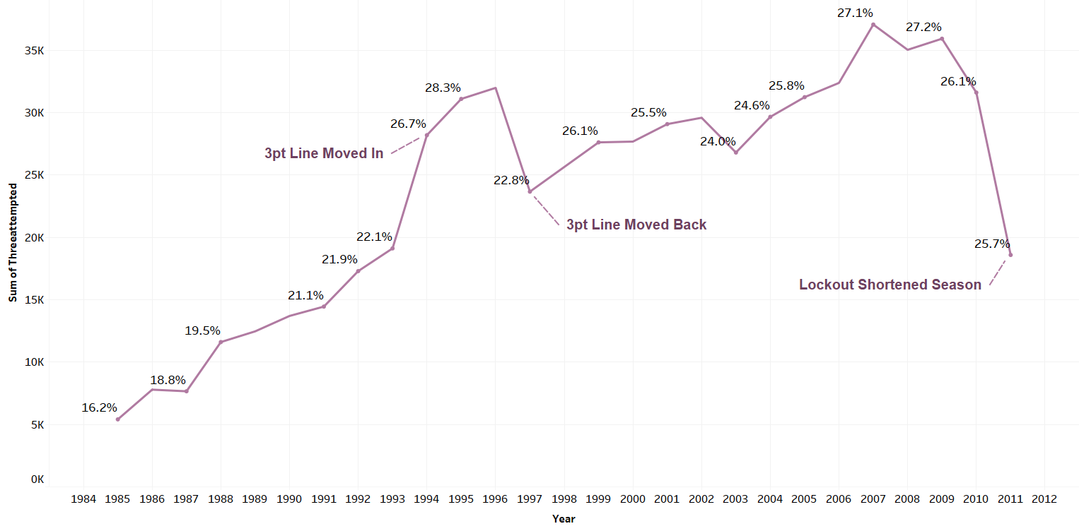
3 Pointers Attempted Per Year with 3pt % Labels (All Players)
3 Point Attempts and Efficiency Have Trended Upwards Since 1985

Slide 14
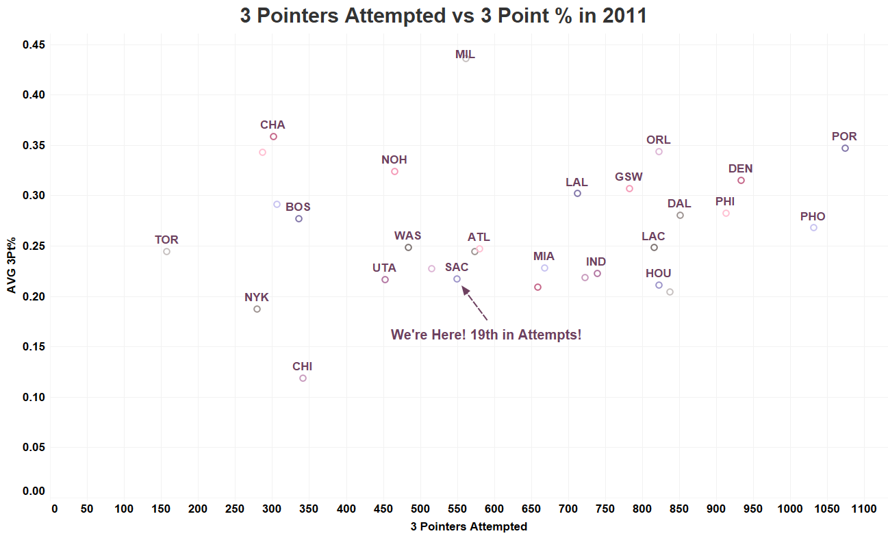
Where Do We Stack Up Against the Rest of the League in 3pts?
In 2011:
19th in Attempts
24th in 3pt %
(Out of 29 Teams)

Slide 15
What Type of Player do We Need? 5 Players Qualified for at Least 58 GP in 2011 on SAC Table Comparing AVGs Between SAC Players (2011) and Last Available All Star Data (2009)
First Name | Last Name | Pos | Feet | Inches | Weight | Games Played | Minutes Per Game | Points Per Game | Rebs Per Game | Asts Per Game | Steals Per Game | Blocks Per Game | TO Per Game | Fouls Per Game | Field Goal % | Free Throw% | 3pt Attempted | 3pt% | Draft Year | Draft Round | Draft Pick
Tyreke | Evans | G | 6 | 6 | 220 | 63 | 34.32 | 16.46 | 4.59 | 4.49 | 1.33 | 0.46 | 2.71 | 2.16 | 45.33 | 77.9 | 99 | 20.2 | 2009 | 1 | 4
James | Fredette | G | 6 | 2 | 195 | 61 | 18.61 | 7.57 | 1.20 | 1.77 | 0.49 | 0.05 | 1.10 | 1.20 | 38.57 | 83.3 | 216 | 36.1 | 2011 | 1 | 10
Isaiah | Thomas | G | 5 | 9 | 185 | 65 | 25.46 | 11.52 | 2.58 | 4.09 | 0.82 | 0.12 | 1.62 | 1.86 | 44.83 | 83.2 | 219 | 37.9 | 2011 | 2 | 30
AVG 2009 | Allstar | G | 6 | 3.86 | 205.7 | 77.3 | 35.84 | 19.08 | 4.18 | 7.65 | 1.20 | 0.34 | 2.83 | 1.92 | 46.29 | 82.9 | 289.1 | 36.3 | N/A | 1 | 5.57
Jason | Thompson | F | 6 | 11 | 250 | 64 | 25.89 | 9.11 | 6.92 | 1.23 | 0.67 | 0.69 | 1.06 | 2.33 | 53.50 | 60.2 | 2 | 0 | 2008 | 1 | 12
AVG 2009 | Allstar | F | 6.07 | 7.79 | 227.6 | 76.1 | 36.47 | 20.82 | 8.94 | 3.47 | 1.13 | 0.96 | 2.53 | 2.68 | 51.62 | 77.9 | 108.1 | 28.8 | N/A | 1 | 9.71
De Marcus | Cousins | C | 6 | 11 | 270 | 64 | 30.47 | 18.13 | 10.98 | 1.59 | 1.45 | 1.17 | 2.66 | 4.02 | 44.84 | 70.2 | 14 | 14.3 | 2010 | 1 | 5
AVG 2009 | Allstar | C | 6.33 | 7.00 | 246.7 | 78.3 | 34.36 | 20.48 | 9.01 | 2.47 | 0.64 | 1.24 | 2.19 | 2.44 | 49.66 | 79.6 | 46 | 20.1 | N/A | 1 | 5.33

Slide 16
Limitations
Limited time frame: 1985-2011
Did not use other statistical methods: WAR, PER
Not Position Specific: No PG Assist, SG Point differences
Mainly looked at AVG: easier to analyze, accounts for players traded midseason
Did not analyze draft busts or players without 70% GP
Excluded Foreign Born Players in Draft Analysis
No 1998-99 Data,
Limited 2011-12 Data

Slide 17
Recommendation, Next Steps
The Player We Draft Needs to Show Proficiency in 3pts Made and Attempts
What are Reasonable Expectations for #5 Pick, Assuming We End Up with the Pick?
What did Allstar Players’ Stats Look Like the Year Before They were Selected to Their 1st ASG?
Do any of our players show similar signs?
Analyze what is of Greater Secondary Need: Assists, Points or Rebounds?
Based on AVG Draft Selection for #5, League Trends, and Team Needs,
This Should be a F with Excellent Outside Shooting
If it’s a G Then They’ll Need to Show High Proficiency in Assists

